Slide 1
Ball Bot
M.TayebZadeh
A.Razaghi
M.Farahat
H.Roodabeh

Slide 2
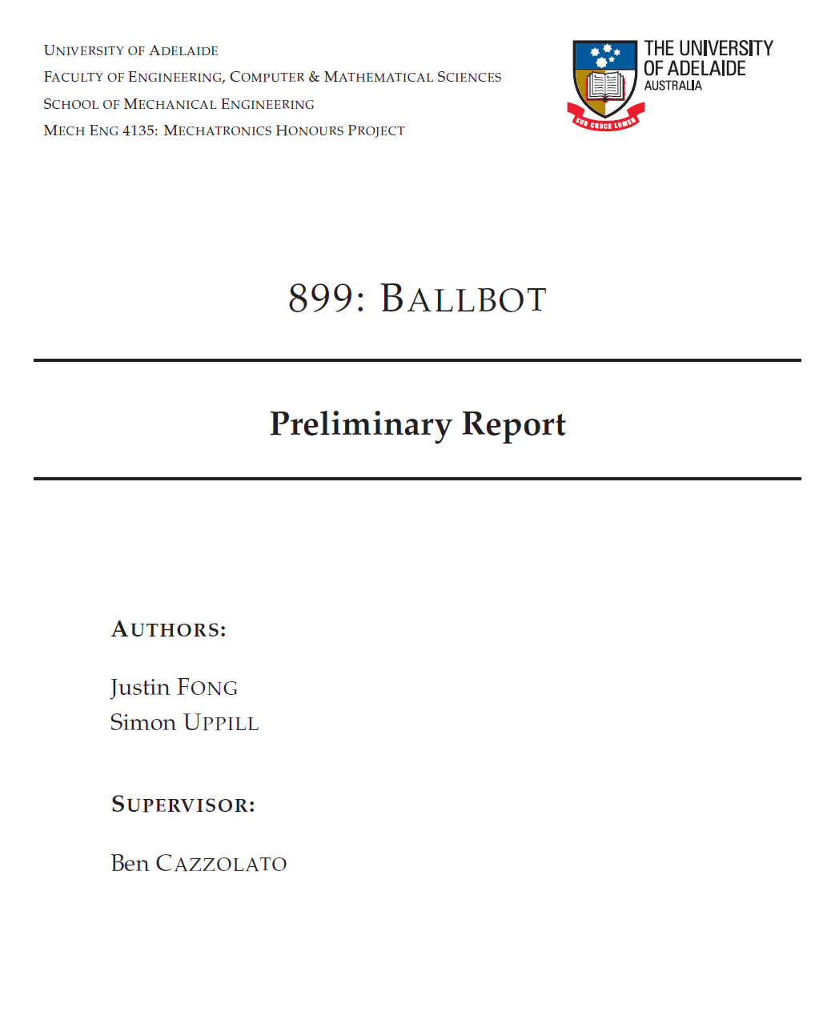
Piece of the Thesis

Slide 3
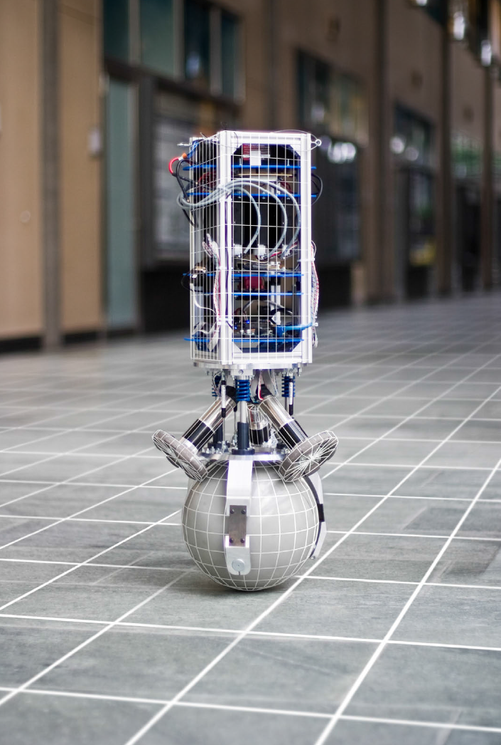
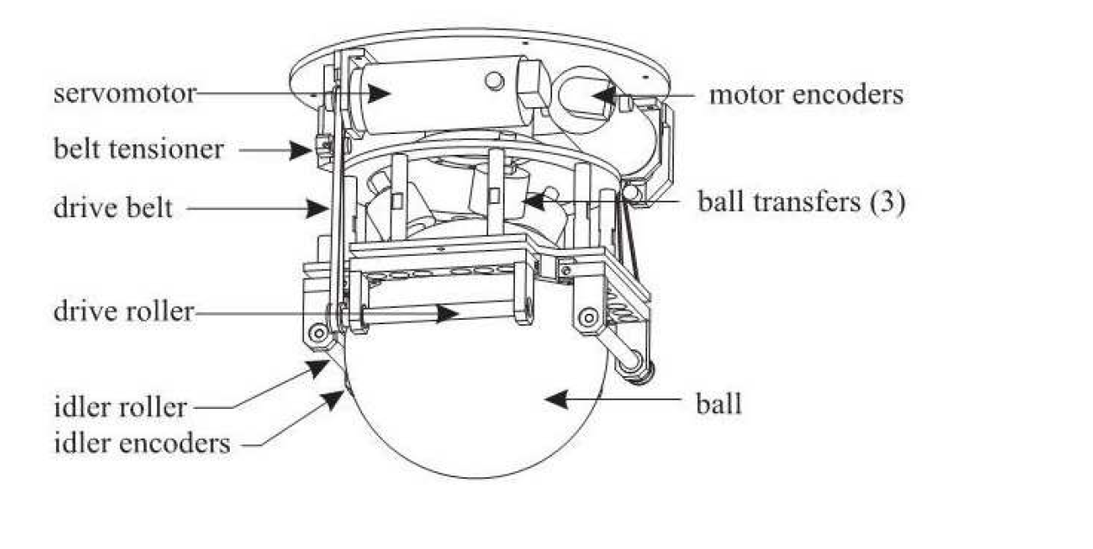
How Does Ball Bot Look like?
balance upright on a ball
Sensors to measure the angle of ballbot tiltTo follow highly dynamic
Two approaches
Servomotor as actuator
First approach
second approach

Slide 4
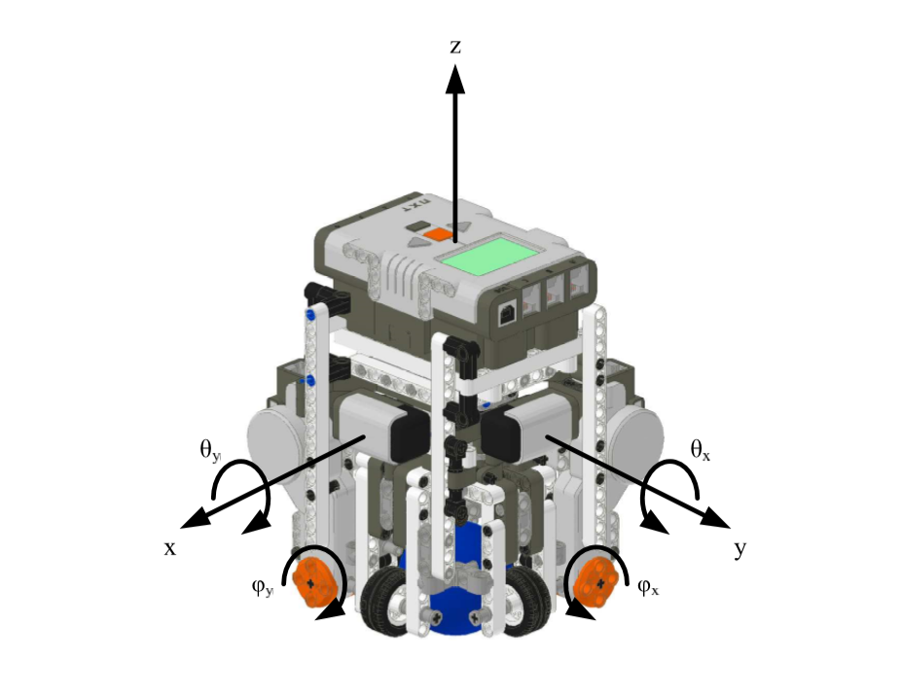
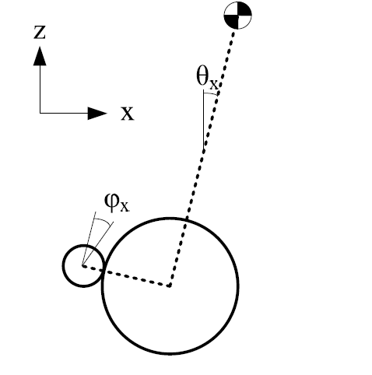
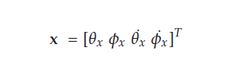
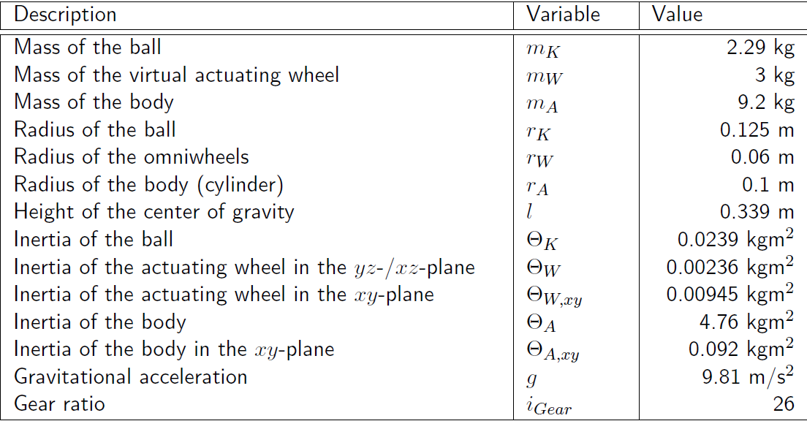

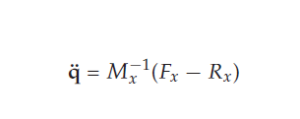
System model in state space
Plane x-z , y-z
State variable
Non-Linear Equations
The Euler-Lagrange equations
S

Slide 5
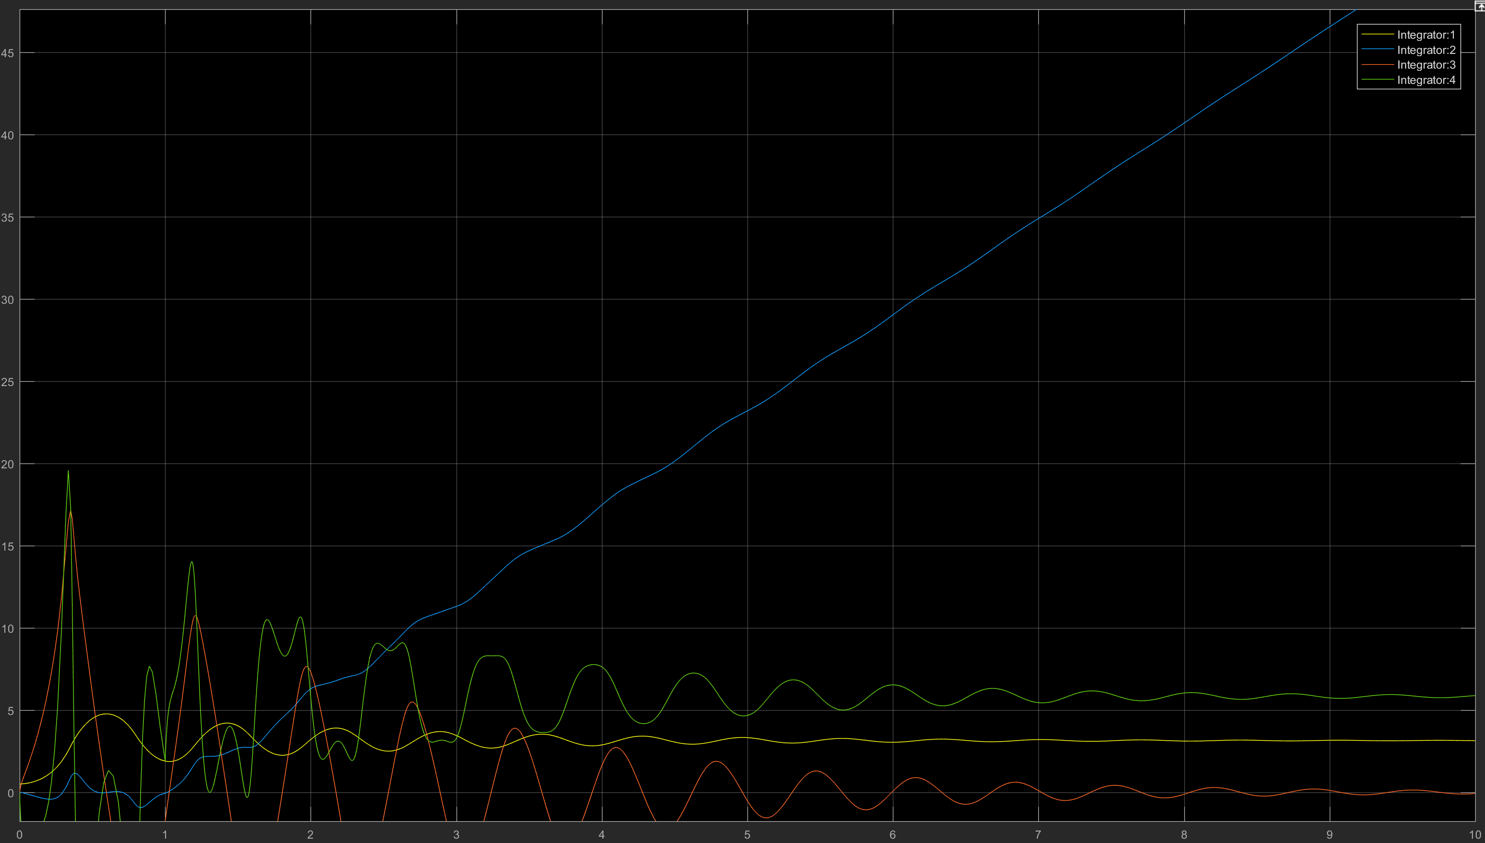
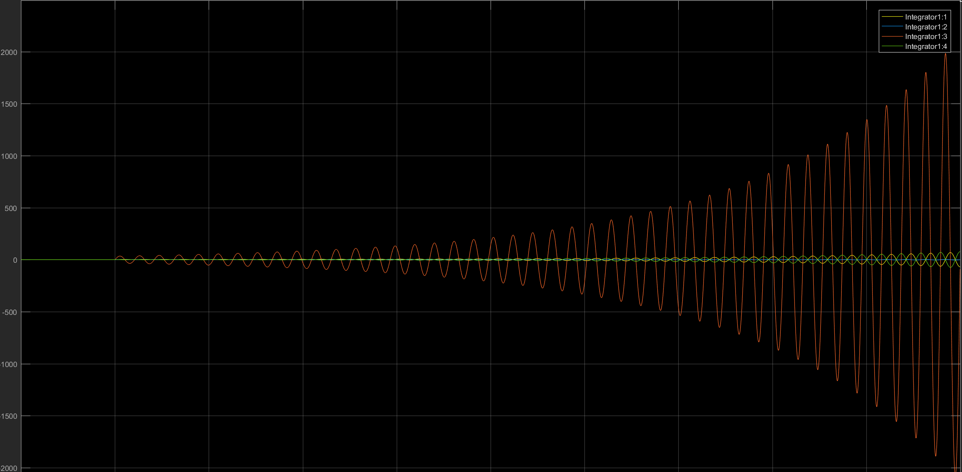
Non-linear
non-linear
Performance of variables
Comparison with linear system
Have some limitation in non-linear system that prevent infinite answer
Analyze open-loop system in steady state
S
linear

Slide 6
Assumptions
Control Goals
No slip
No Friction
NO Deformation
Fast Motor Dynamics
Stablize system
Converge angle between ball and axis to zero or Swing around zero(first variable state )
S

Slide 7

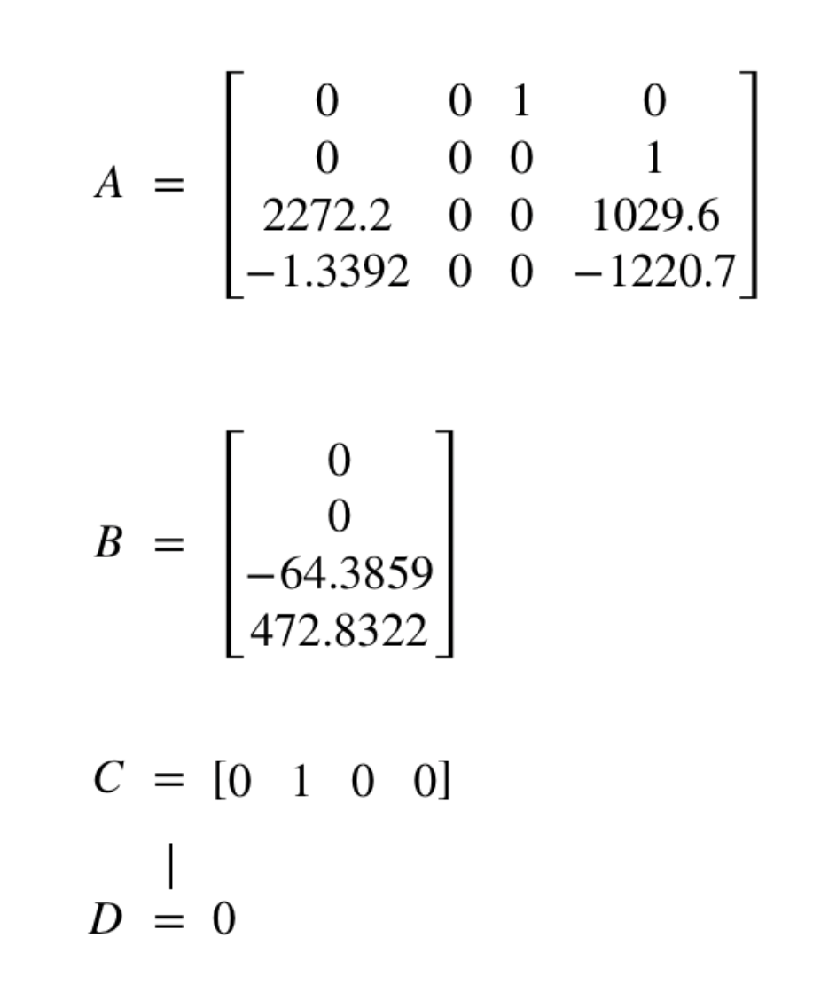
The Area system works

Slide 8
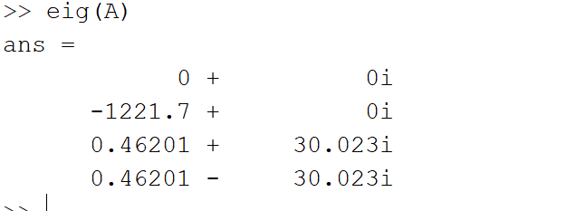
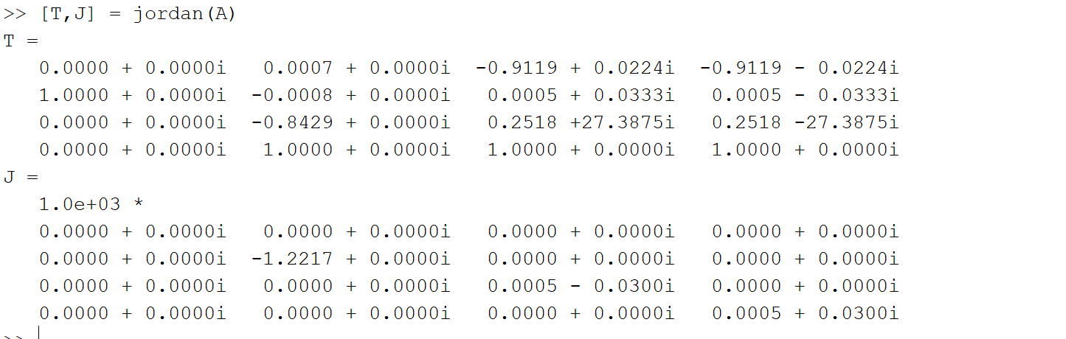
Jordan form
Modes of system
Jordan form
and similarity transfer

Slide 9
Transfer matrix
???????????????

Slide 10
no region of attraction
According to the last slides
We have infinite answer in linear model with any initial values
But we have some limitation in non-linear and never have infinite answer
Overally because we have unstable system , region of attraction is an empty space

Slide 11
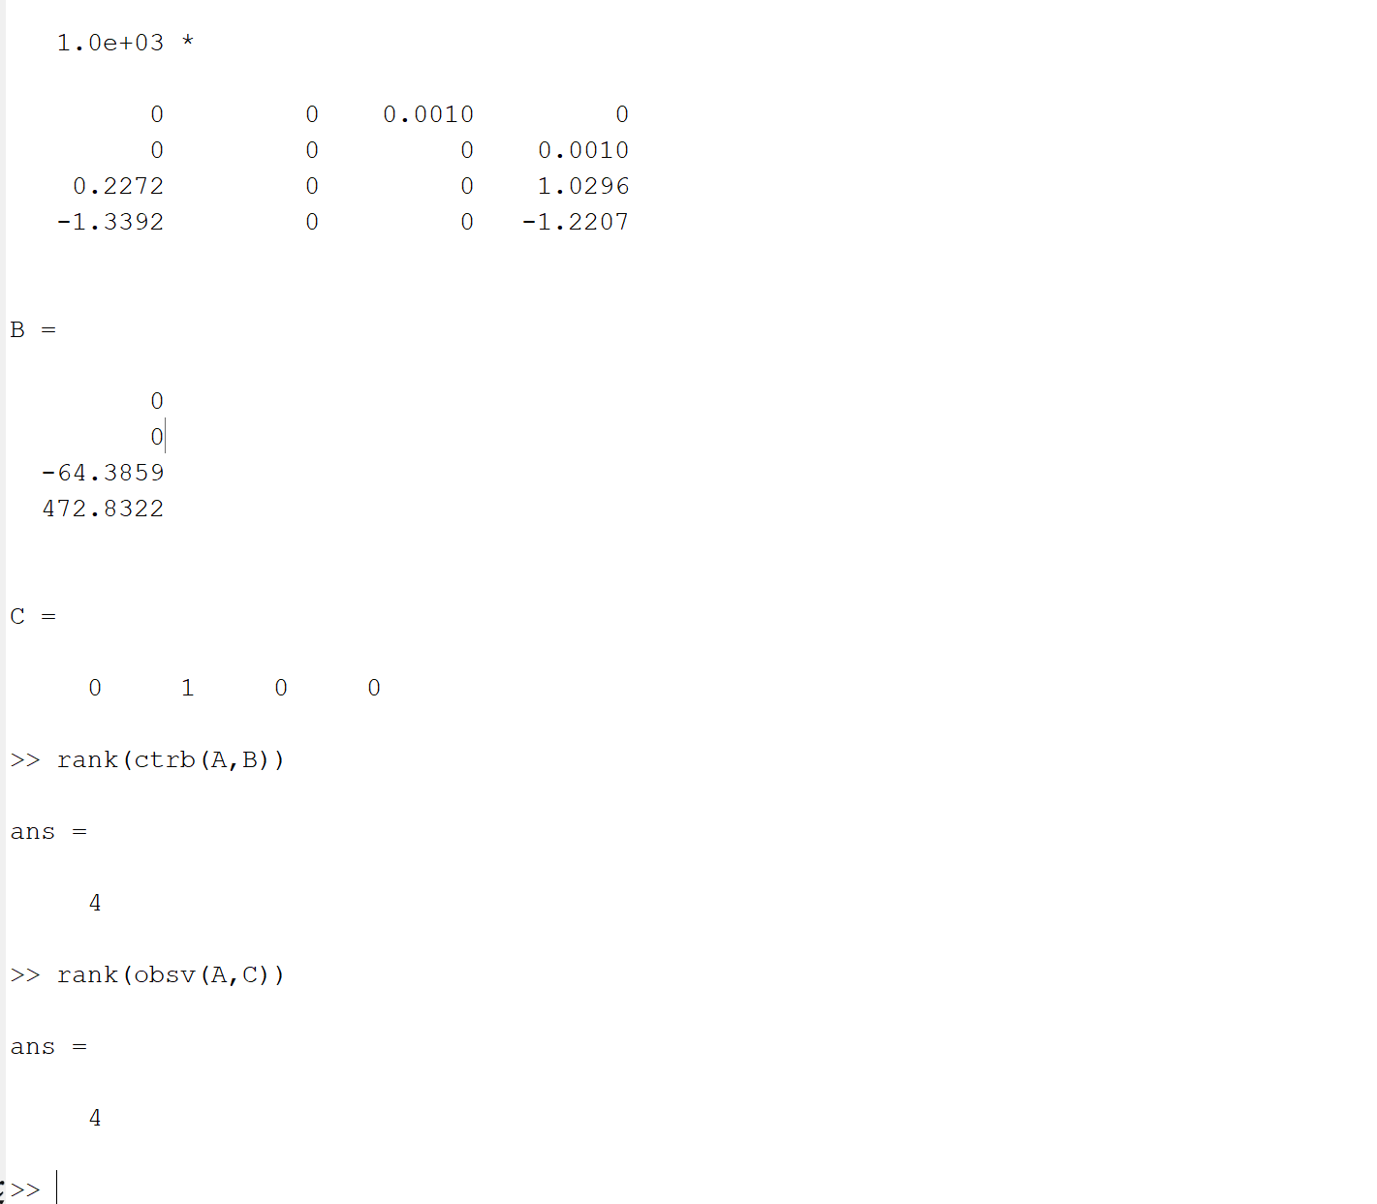
Controballity and observability
Our realization is minimal
So we don’t need colman decomposition
So we can control and observe
All the poles even unstable poles

Slide 12
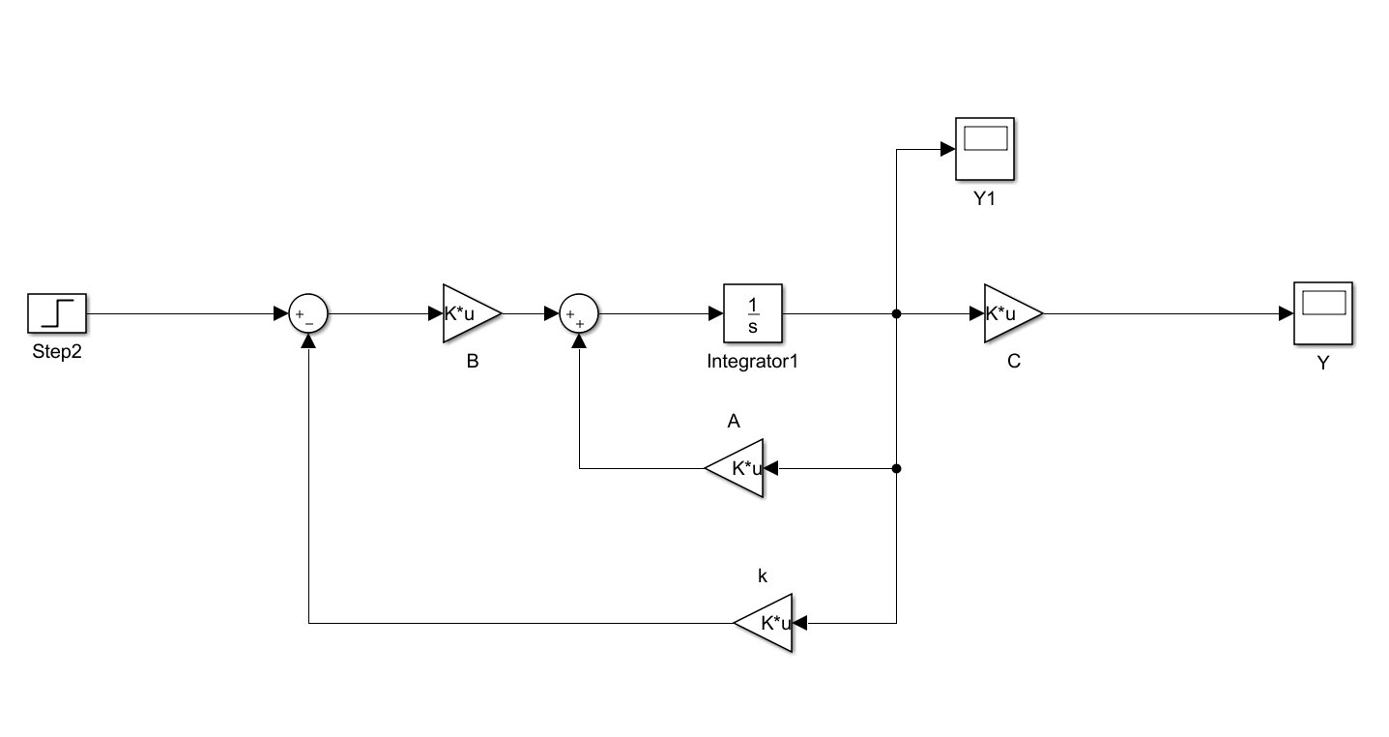
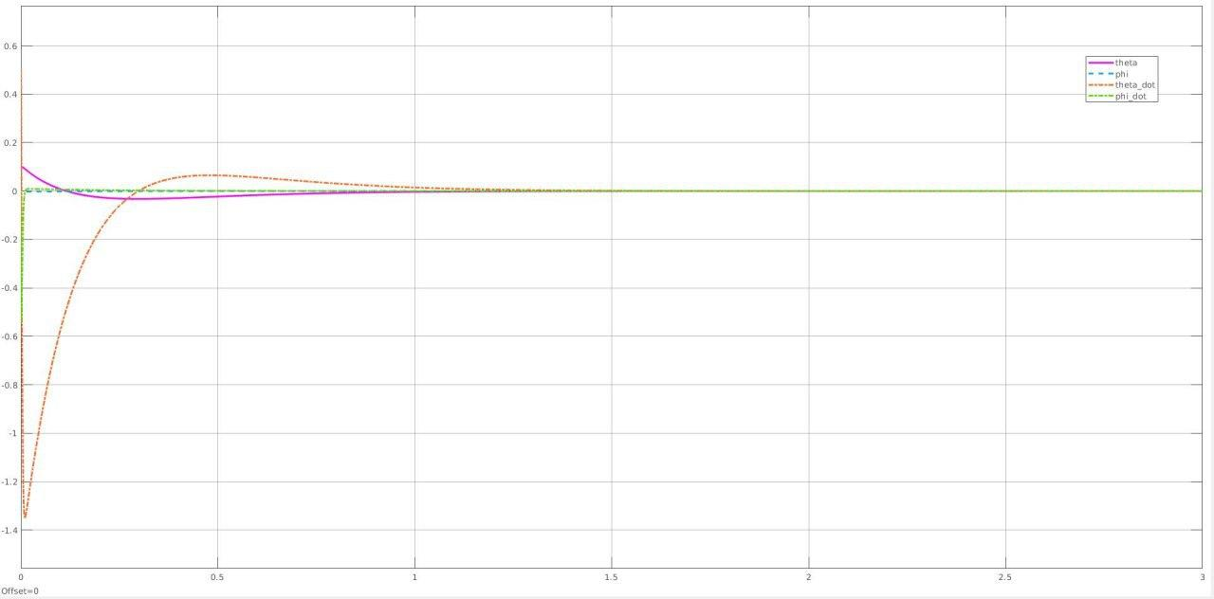
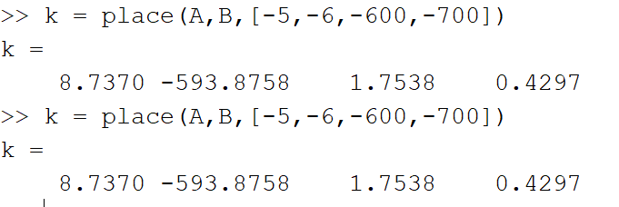
Second part
State Feedback

Slide 13
Second part
State Feedback with static gain
Because our reference input is zero
, it’s multiplication with any gain will be zero .
Our plant input is voltage
Output are angles and speeds we defined

Slide 14
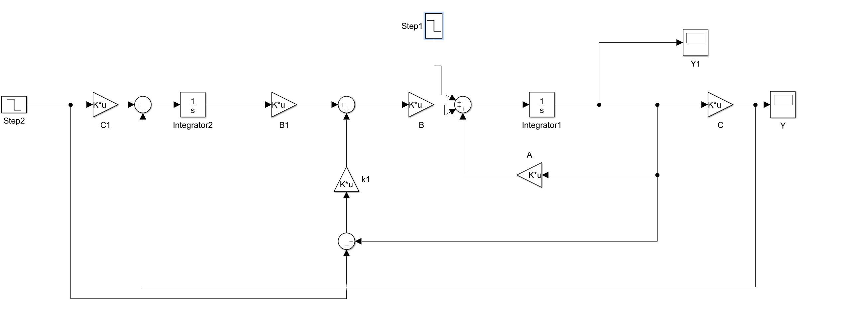
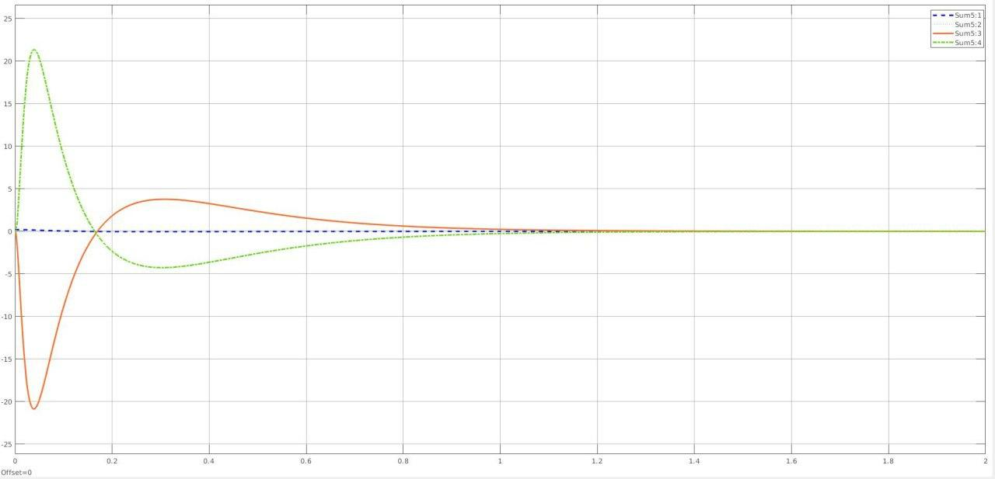
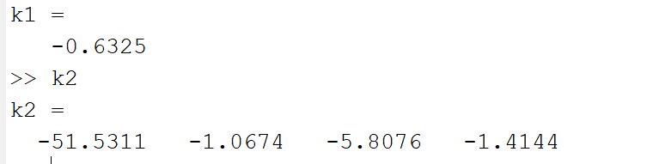
Second part
State feedback with integrator and dynamically

Slide 15
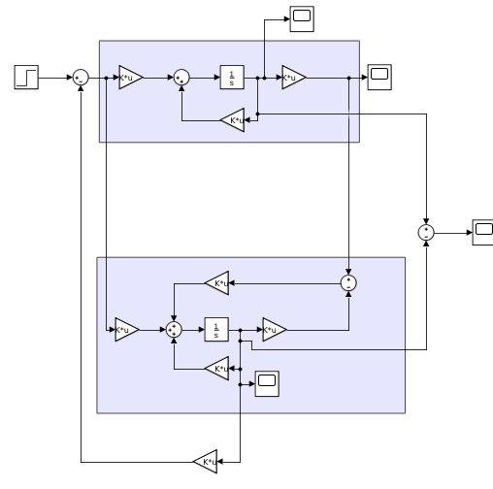
Second part
Complete Observer - linear model

Slide 16
Second part
Complete Observer - linear model

Slide 17
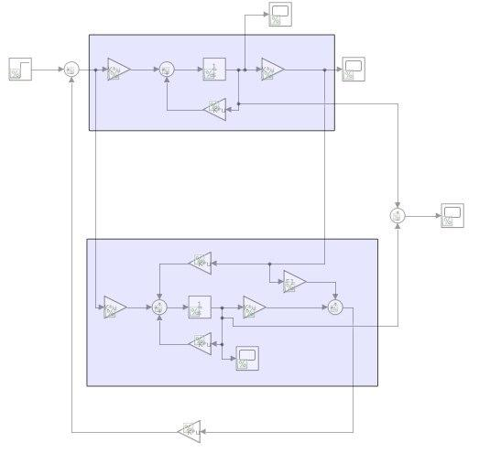
Second part
Reduced Observer - linear model

Slide 18

Third part
Equilibrium points
Lyaponov
(first method of lyaponov was done at last slides . )

Slide 19
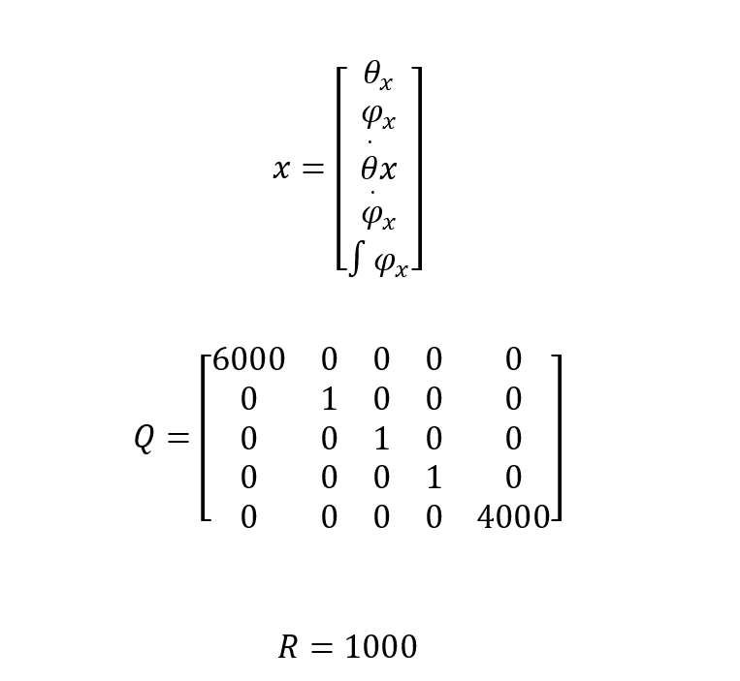
Third part
To omit the error at state variables , we add one extra variable something like state feedback with integrator in a dynamic manner .
LQR

Slide 20
REFERENCES

Slide 21
Thanks for your attention,
Any questions?

